Slide 1
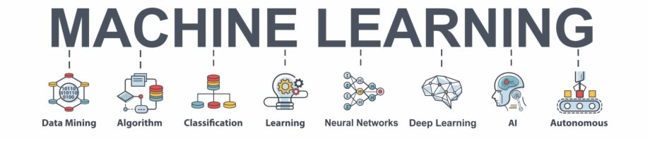
CAT V/S DOG IMAGE CLASSIFICATION USING CNN, VGG-16 AND VGG-19
Machine Intelligence
Mini Project
PROJECT TITLE : CAT V/S DOG IMAGE CLASSIFICATION USING CNN, VGG-16 AND VGG-19

Slide 2
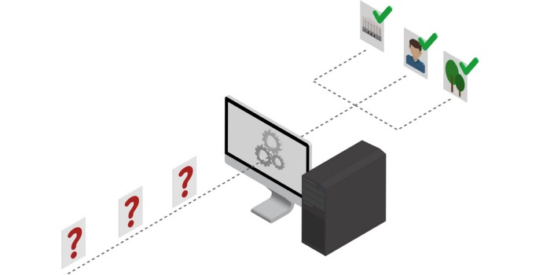
PROBLEM STATEMENT:
TEST AND CLASSIFY AN IMAGE AS CAT AND DOG USING DEEP LEARNING ALGORITHMS
INTRODUCTION & FIELD :
As the topic name suggests, this MI project is about the identification of cats and dogs or its related family by images, using various kinds of MI algorithms such as KNN, VGG, CNN with techniques of deep learning too. Also we will show, the best of all algorithms used for the problem statement. The tools mainly used for this project are :
Kaggle (For intensive datasets)
Jupyter Notebook/Google Colab to run the code.
Python : For the coding of MI algorithms.
This project is completely based on MI field, so we even show how the machine learns from the datasets to identify and then classify the images.
SCOPE & DELIVERABLES :
This project returns the answer telling whether the image is a cat or dog. Apart from that the accuracy of each operation performed is mentioned with the related statistics. Also, an extensive will be displayed showing which algorithm was the best in this classification.
Notes:
Provide a basic introduction of the project and also an overview of scope it entails.
Set the context.

Slide 3

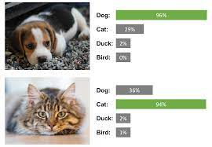
APPLICATION AND USES
Basically to identify the images of cats and dogs in a large database of pet images. Can be extended to many classes of images.
To fetch images of the searched text. For Eg : When we search for cat in browser, we get the respective images, etc….
Helpful in NLP to filter out the results.
Image based scanning, face recognition.
Helps in recognizing image captchas.
To analyse a new species if found with the existing species of animals there.
To produce achieve image generator with correct labels, with the help of the classification of images in the large database.
Notes:
Provide a basic introduction of the project and also an overview of scope it entails.
Set the context.

Slide 4

HIGH LEVEL ARCHITECTURE : CNN
Notes:
Provide a basic introduction of the project and also an overview of scope it entails.
Set the context.

Slide 5

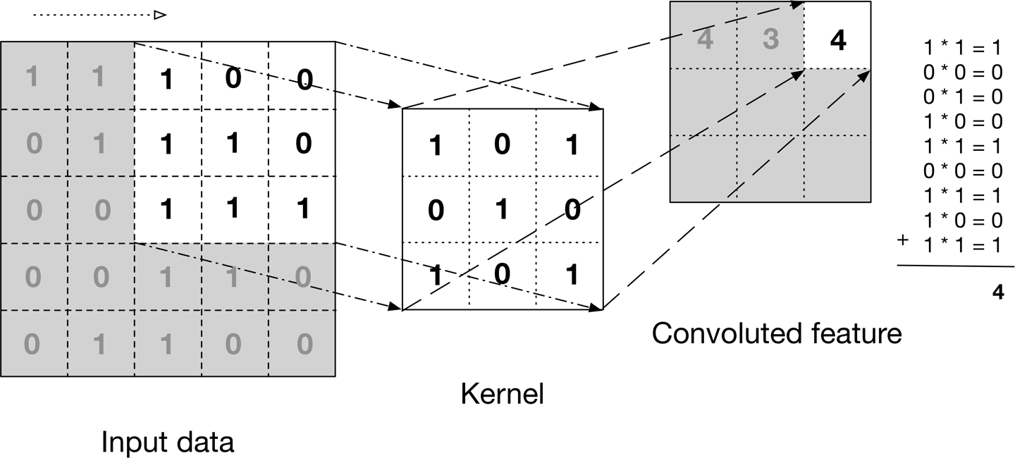
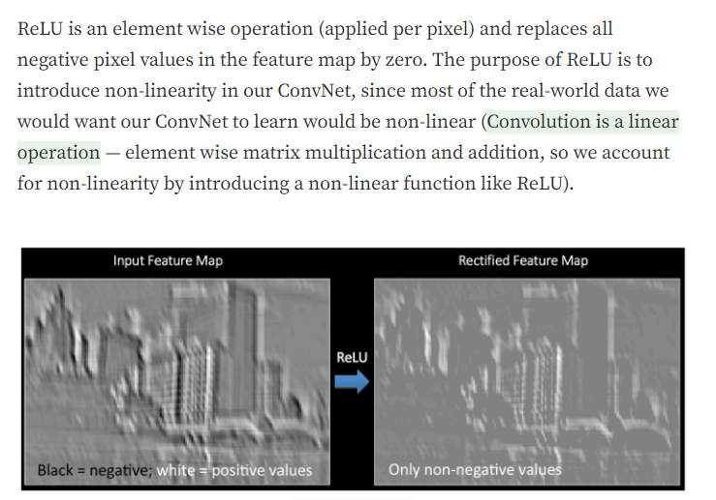


HIGH LEVEL ARCHITECTURE : CNN : CONVOLUTION LAYER
Notes:
Provide a basic introduction of the project and also an overview of scope it entails.
Set the context.

Slide 6
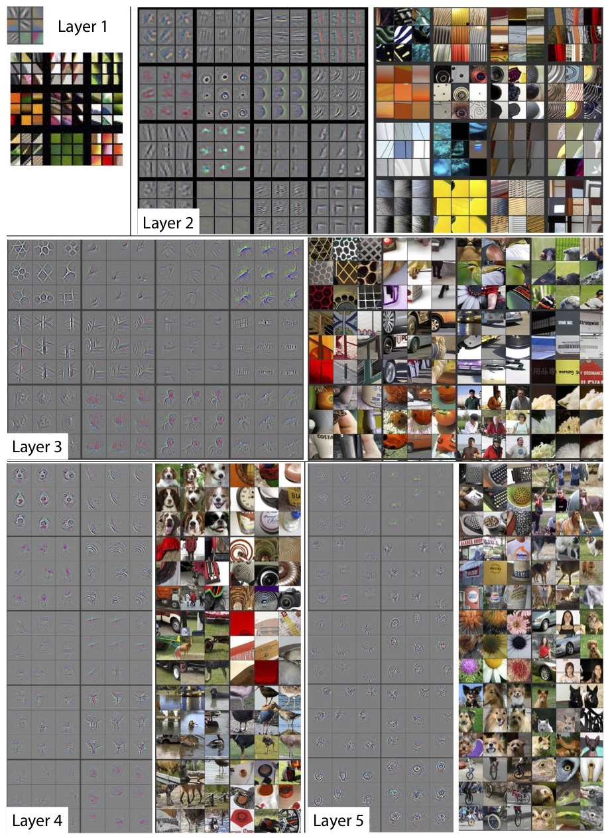



HIGH LEVEL ARCHITECTURE : CNN : POOLING LAYER
Notes:
Provide a basic introduction of the project and also an overview of scope it entails.
Set the context.

Slide 7
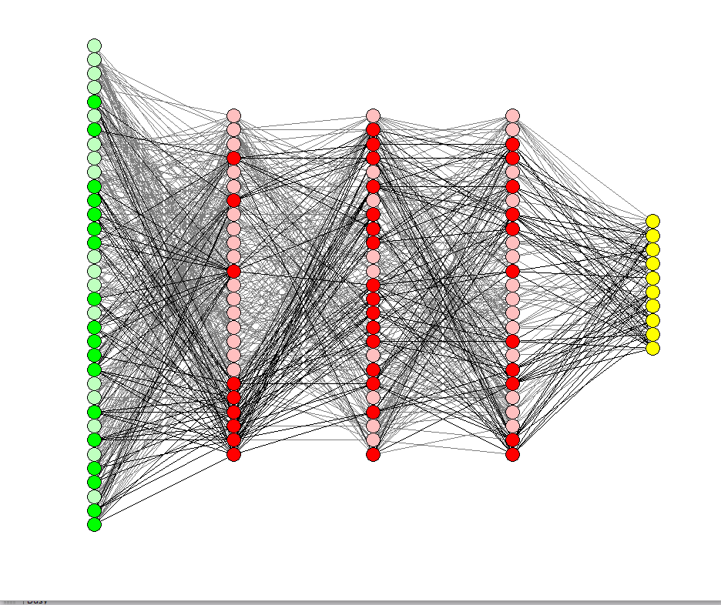
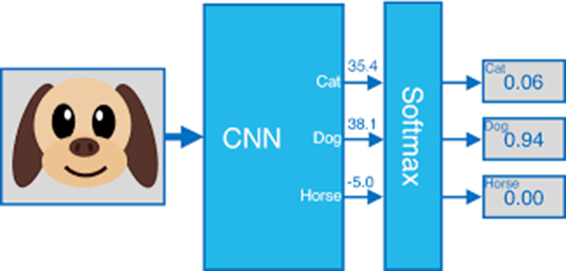
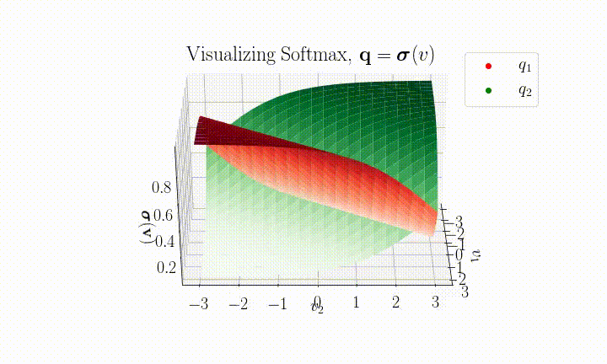

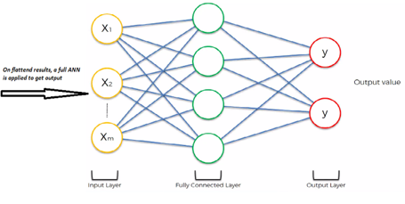

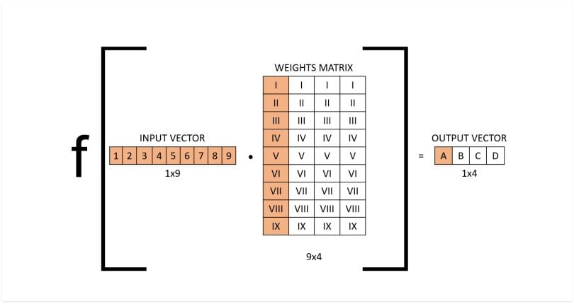
HIGH LEVEL ARCHITECTURE : FULLY CONNECTED LAYER & SOFTMAX
Notes:
Provide a basic introduction of the project and also an overview of scope it entails.
Set the context.

Slide 8
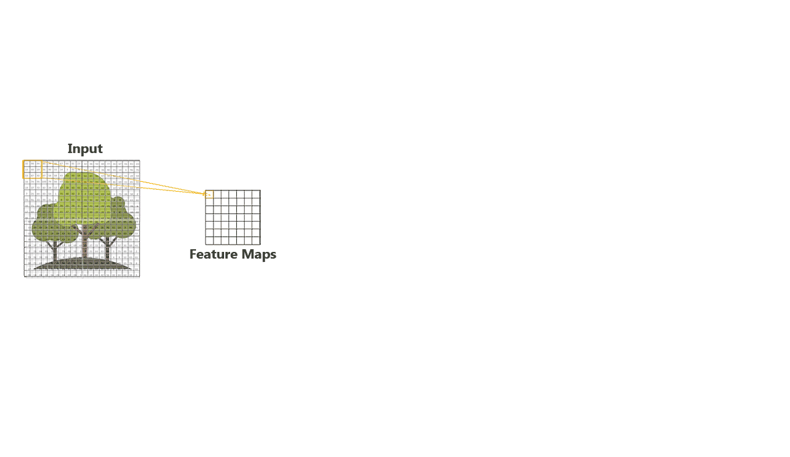
HIGH LEVEL ARCHITECTURE : CNN : OVERALL
Notes:
Provide a basic introduction of the project and also an overview of scope it entails.
Set the context.

Slide 9
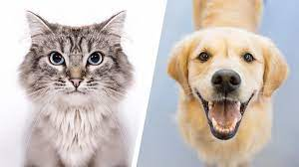

CONTD…
IN PART 2

